Slide 1
CloudComputing
What is Cloud Computing ?
It is a model where all IT resources and services are stored over the internet and provided on demand & at scale in a multi-tenant environment.
On Demand- Resources can be provided immediately when needed, released when no longer required and billed for only when used.
At Scale- Service provides resource availability to meet whatever demands are made.
Multi Tenant- Resources are provided to many customers from a single implementation.
In other word we can say :
It is the use of remote servers on the internet to store, manage and process data rather than a local server or personal computer.

Slide 2
Characteristics of Cloud :-
1. On demand self service
- Can build server, network & storage as needed without interacting with service provider or System Administrator
2. Broad network access
- Resources can be accessed globally through internet from anywhere
3. Scalability
- Resources can be automatically increased & decreased as well as required.
4. Resource pooling
- Provide resource to multiple customers from through same physical resource by securely separating the resources at logical level.
5. Measured services
- Resources are billed as per usage i.e. pay as you go

Slide 3
Cloud Service Models
There are three types of service models in cloud − IaaS, PaaS, and SaaS :-
1.IaaS(Infrastructure as a Service)
>It provides users to process, storage, and network connectivity on demand.
>This service provides the infrastructure like Servers, Operating Systems, Virtual Machines, Networks, and Storage on rent basis.
>When you have the software and the platform ready but you want the hardware to run then you use IaaS.
2. PaaS(Platform as a Service)
>A PaaS vendor provides hardware and software tools over the internet, and people use these tools to develop applications.
>Primarily used by developers who are building software or applications.
>It’s kind of like the difference between hiring a venue to put on a show vs. building a venue to put on a show.
>When you have a software developed by you, but you want to deploy and run on a publicly available platform then you use PaaS
3.SaaS(Software as a Service)
>The third-party providers provide end-user applications to their customers with some administrative capability at the application level, such as the ability to create and manage their users.
>It make software available to users over the internet, usually for a monthly subscription fee.
>When you are a simple client who wants to make use of a software but you have nothing in hand then you use SaaS.

Slide 4
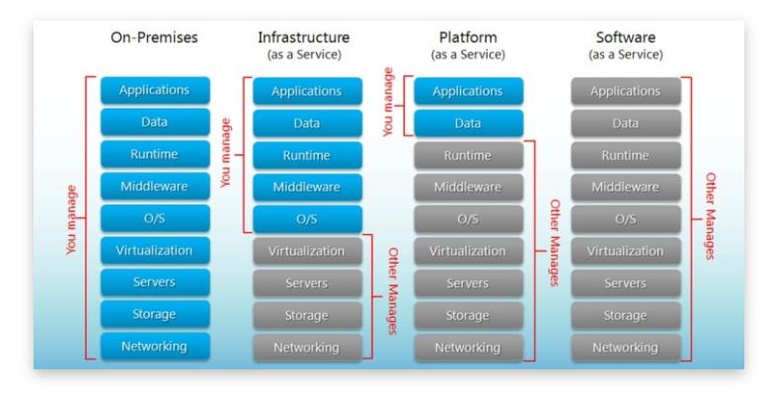

Slide 5
Types of Clouds:-
There are three types of cloud − Public, Private, and Hybrid cloud.
Public Cloud
>In public cloud, the third-party service providers make resources and services available to their customers via Internet.
> A publicly accessible cloud infrastructure that allows you to store cloud resources.
>Customer’s data and related security is with the service providers’ owned infrastructure.
>It is like renting an infrastructure for a specific period of time.
Private Cloud or Enterprise Cloud
>It is almost similar to the public cloud, but the data and services are managed by the organization or by the third party only for the customer’s organization.
>Cannot be accessed publicly.
>In other words, it refers to an organization’s own private data canter
Hybrid Cloud
>A hybrid cloud is the combination of both private and public cloud.
>The decision to run on private or public cloud usually depends on various parameters like sensitivity of data and applications, industry certifications and required standards, regulations, etc.

Slide 6
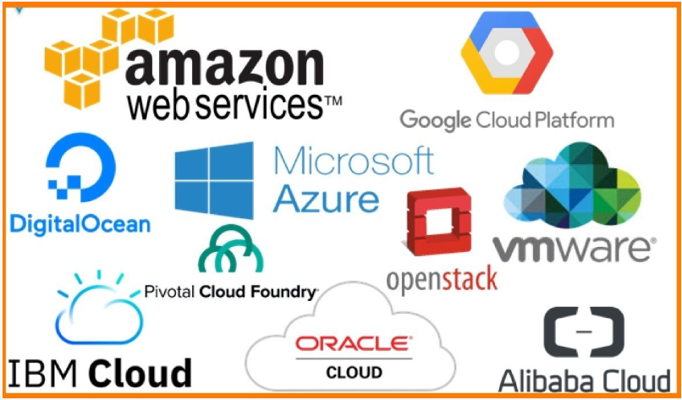

Slide 7
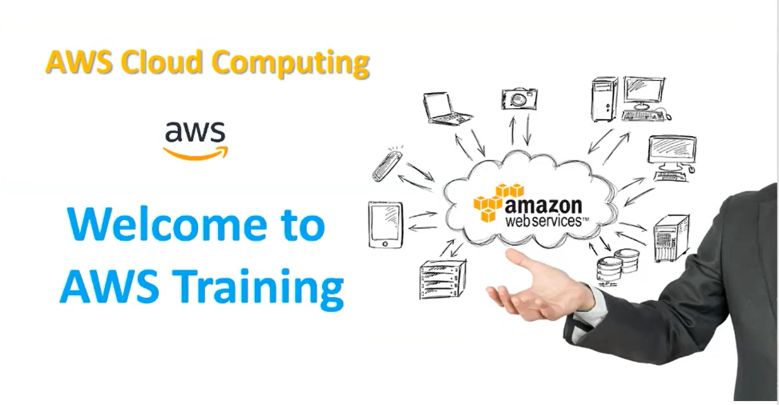

Slide 8
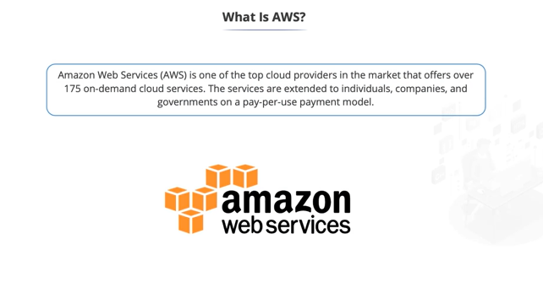

Slide 9
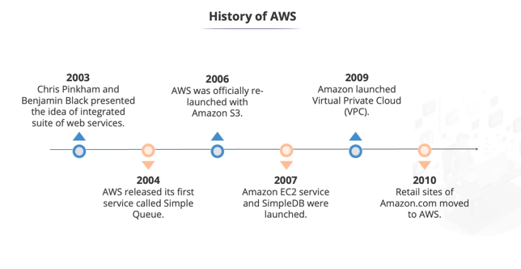

Slide 10
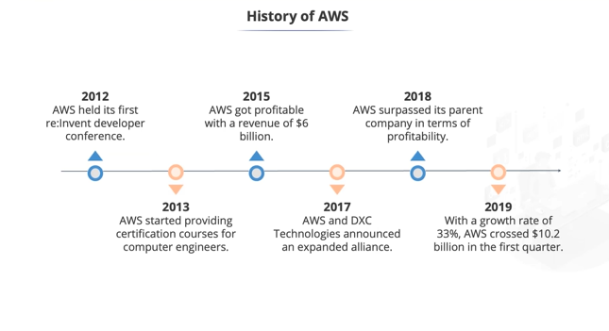

Slide 11
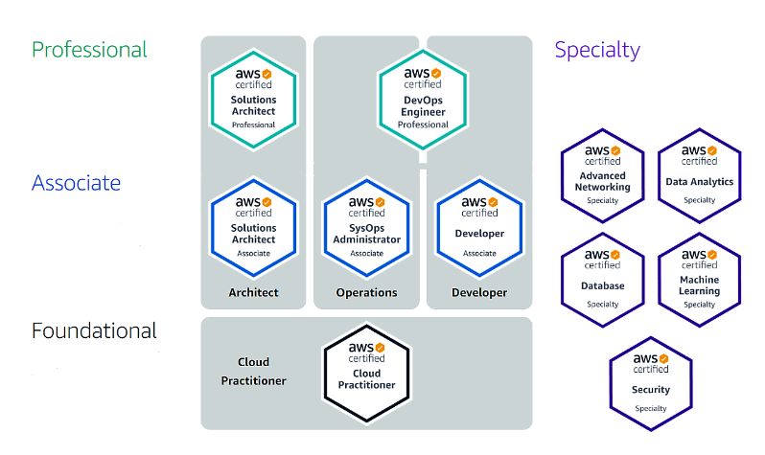
AWS Certification - Started in 2013

Slide 12
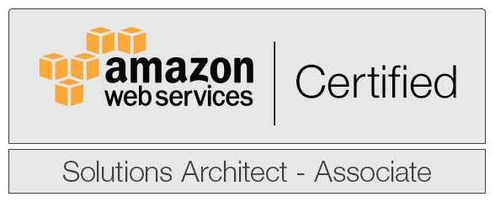
amazon

Slide 13
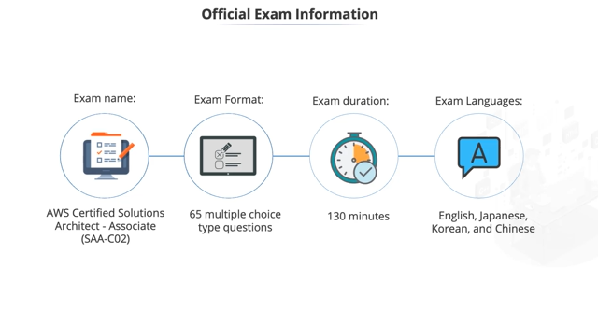

Slide 14
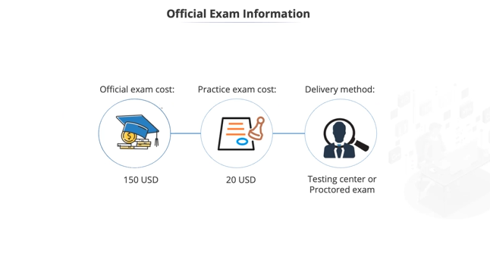

Slide 15
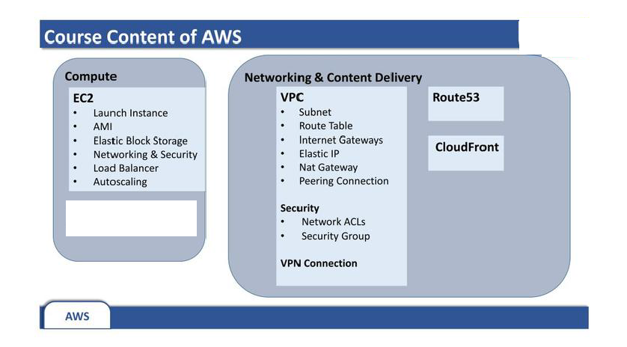


Slide 16
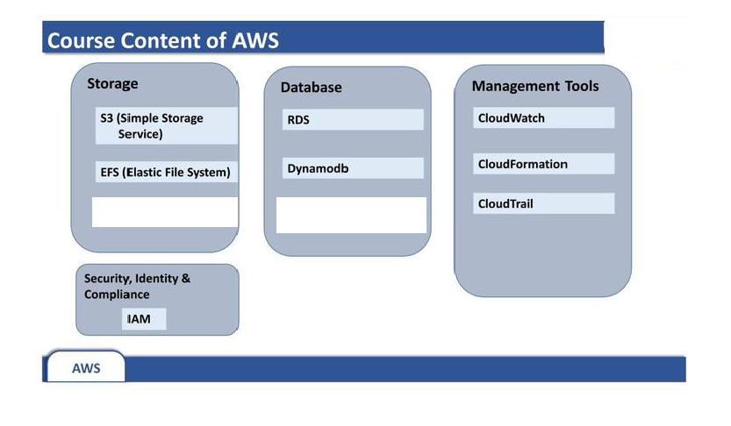


Slide 17
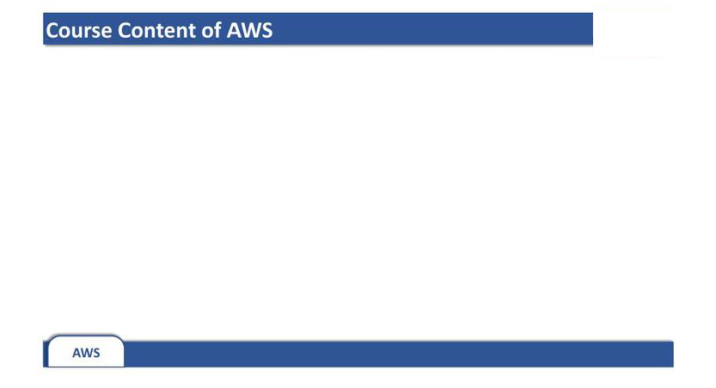
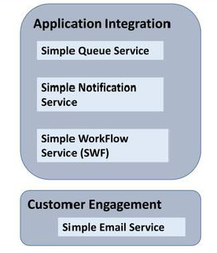


Slide 18
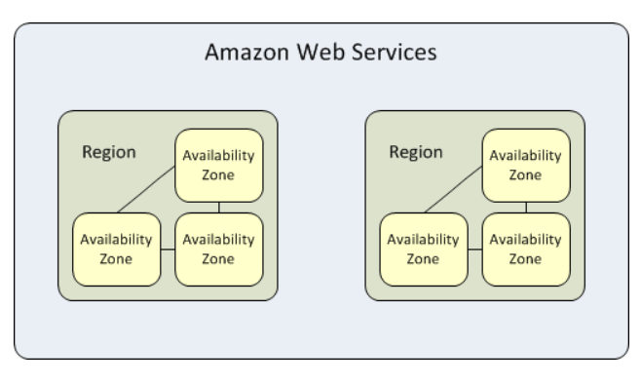
AWS Global Architecture

Slide 19
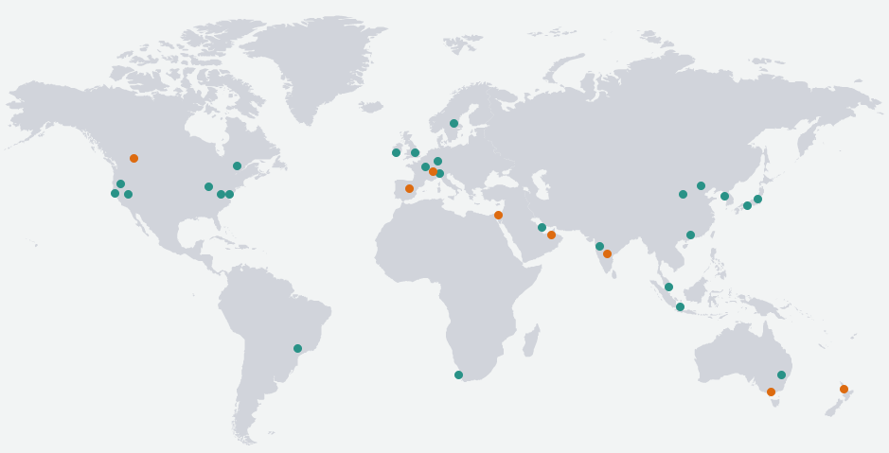
Total Regions = 26 (Announced Plan = 8), Total AZs = 84 (Announced Plan = 24)

Slide 20
Region :-
- An AWS Region is a geographical location with a collection of availability zones mapped to physical data centers in that region.
- Every region is physically isolated from and independent of every other region in terms of location, power, water supply, etc.
- The largest AWS region, us-east-1, has five zones.
Availability Zone :-
An availability zone is a logical data center in a region available for use by any AWS customer.
Each zone in a region has redundant and separate power, networking and connectivity to reduce the likelihood of two zones failing simultaneously.
NOTE :
1 Region = Multiple AZs (Minimum 3)
1 AZ = Cluster of DC

Slide 21
AWS Management Console:-
- The AWS Management Console is a browser-based GUI for Amazon Web Services (AWS).
- Through the console, a customer can manage their cloud computing, cloud storage and other resources running on the Amazon Web Services infrastructure.
Setting Up AWS Account :-
- Visit aws.amazon.com

Slide 22
